Slide 1

C369 Financial Technologies
Graded Assignment Milestone 1
Ho Yao Ming Lazel
23049933

Slide 2
Identify a problem people face in the financial services industry.
Many people, regardless of their background or profession, encounter challenges when it comes to managing their finances. It's tough to keep track of what you spend and its tougher to say no to buying things impulsively, especially when friends or family members push you to. And saving up for the future adds another layer of difficulty, needing you to be disciplined and plan ahead, even with all the distractions of everyday life.

Slide 3

Describe the people most affected by this problem (your target audience)
Youths aged between 16 to 23 who struggle with managing their expenses
Many youths frequently find themselves in financial distress, having to live allowance to allowance or paycheck to paycheck. Their spending patterns tend to be quick and impulsive rather then for the long-term. They usually have difficulty distinguishing between needs and wants and may succumb to societal or peer pressure when keeping up with the latest trends or maintaining a certain lifestyle.
Budgeting may feel like a very difficult task for them, and they usually lack the discipline or the know how when creating a budget and following its rules regularly and effectively. As a result, they tend to overspend on non-essentials like in-game purchases or dining out regularly at expensive restaurants, leaving them with little to no money for savings for emergencies.

Slide 4

Review recent FinTech trends
Digital pocket money - the concept of giving young people an allowance or spending cash in a digital form, usually through a mobile application or internet platform. Rather than tangible money, young individuals handle their finances digitally, utilizing their smartphones or other gadgets to make purchases, monitor their spendings, and even establish savings objectives.
The use of digital money instead of fiat currency allows youths to view their spending habits, view transaction history, and even set spending limits or restrictions. . This give youths a sense of accountability, encouraging them to make informed choices and stick to their budgets.
It is also convenient for youths as digital pocket money reduces or eliminates the need for them to carry physical cash, reducing the risk of loss or theft. With only their smartphone and internet access, they can access their money anytime, anywhere.

Slide 5
Propose a solution to address the problem you identified.
An all-in-one app that includes budgeting tools, expense tracking features as well as payment features. The app will use embedded finance, open banking, as well as blockchain features. This app analyzes spending patterns and offer personalized budgeting tips and send reminders to help youths resist peer pressure and make more informed spending decisions, helping them manage their allowances and part-time earnings more effectively.
The app also offers automated savings features and goal-based saving accounts, making it easier for youths to set aside money for future expenses like school or travel.

Slide 6
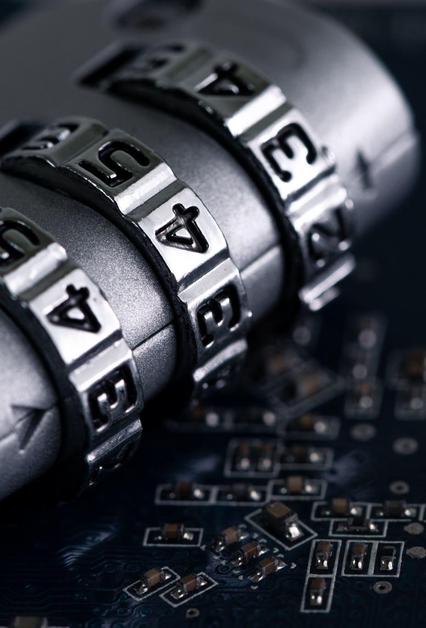
Indicate relevant MAS regulations and compliance requirements
Payment Services Act (PSA)
Anti-Money Laundering (AML) and Countering the Financing of Terrorism (CFT) Regulations
Personal Data Protection Act (PDPA)
Cybersecurity Regulations

Slide 7
Features to address fraud prevention and AML compliance
Multi-factor Authentication (MFA): Implement a layered approach to MFA, combining traditional methods like passwords and security questions with more advanced options such as OTP, biometrics (fingerprint, facial recognition), and government-backed authentication systems like SingPass. Furthermore, the system will always allow users to choose their preferred MFA methods while ensuring that at least two factors are always required for authentication.
Identity Verification: Require users to verify their identity by using documents such as government-issued IDs, passports, or utility bills to ensure that they are who they claim to be when they sign up for an account.
AML Screening: Screen customers against global watchlists, sanctions lists, and PEP databases during sign-up to identify individuals involved in illegal activities or high-risk profiles.
KYC Compliance: Collect and verify customer information to comply with KYC regulations, updating profiles periodically to assess risk and ensure ongoing compliance..

Slide 8

Explain the emerging technologies employed in your solution.
Secure Account Aggregation(Open Banking): Implement Open Banking APIs to securely aggregate users' financial data from multiple banks and financial institutions into the app. This allows users to view all their accounts and transactions in one place, including checking, savings, and credit card accounts.
Blockchain Integration for Security: Integrate blockchain features into the app to enhance security and transparency. Use blockchain technology to secure users' financial data and transactions, providing an immutable record of all transactions for added peace of mind
Real-time Transaction Monitoring and Fraud Detection: Implement advanced systems powered by algorithms, machine learning, and Open Banking APIs to monitor customer transactions in real-time. This allows the detection of any unusual or suspicious activities that may indicate potential fraud or money laundering. By analyzing patterns of behavior and transaction history, these integrated tools help prevent fraudulent transactions and ensure the security of customer accounts.

Slide 9
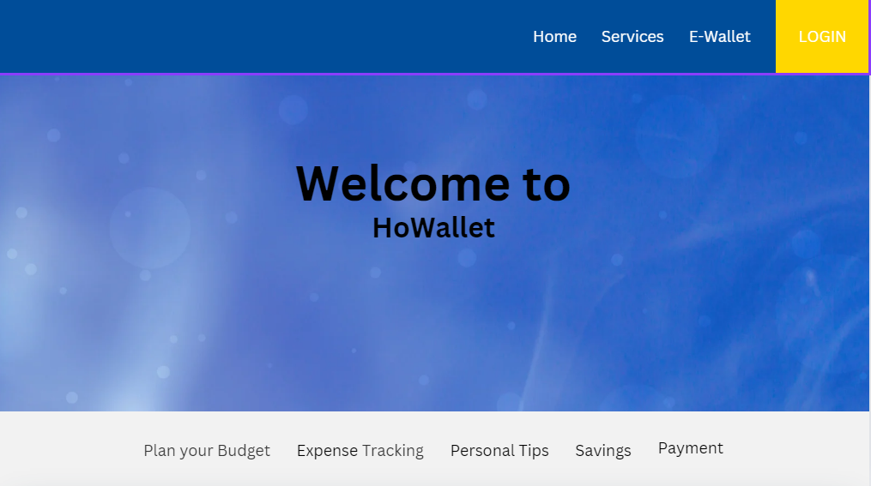
Home page

Slide 10
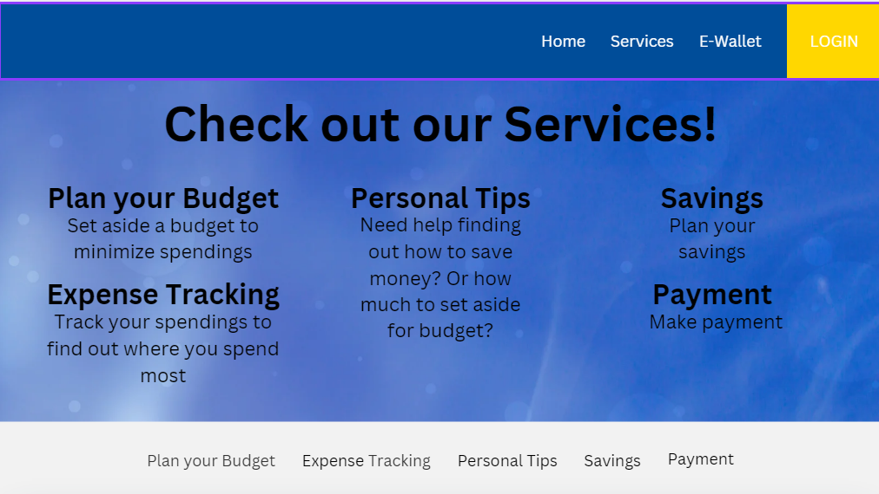
Services page

Slide 11
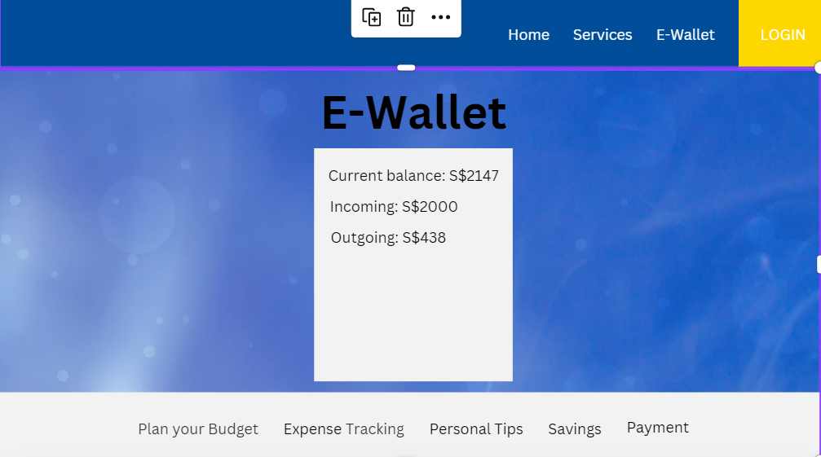
E-wallet page

Slide 12
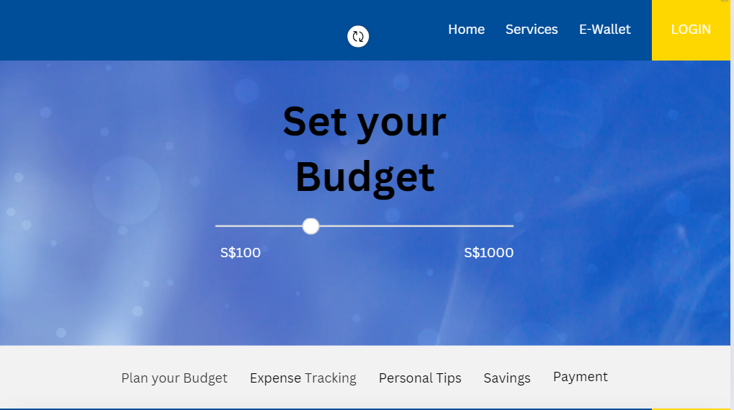
Budget page

Slide 13
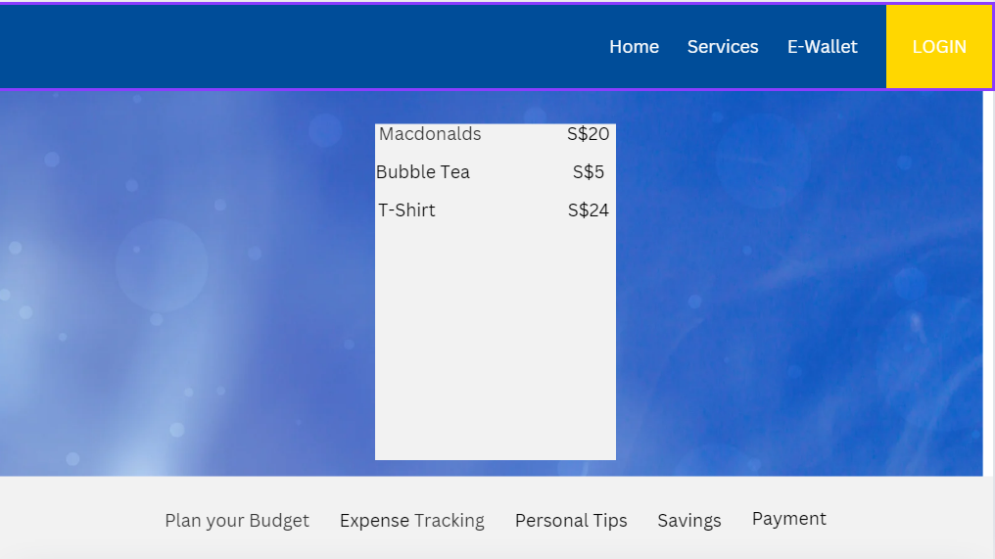
Expense Tracking Page

Slide 14
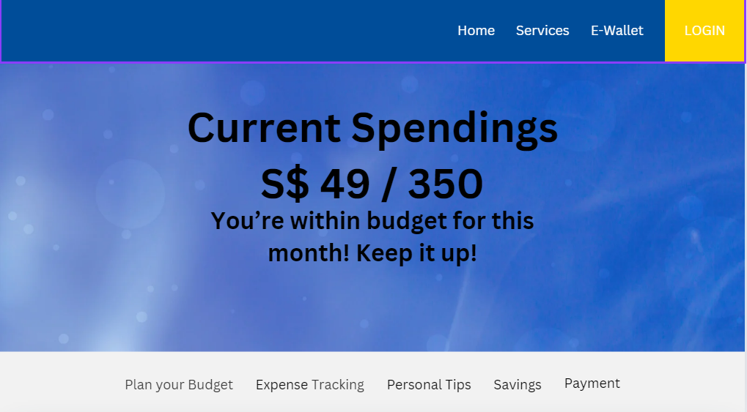
Personal Tips page

Slide 15
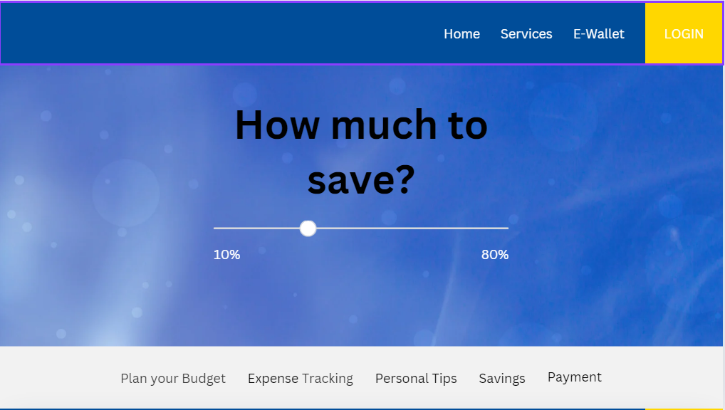
Savings page

Slide 16
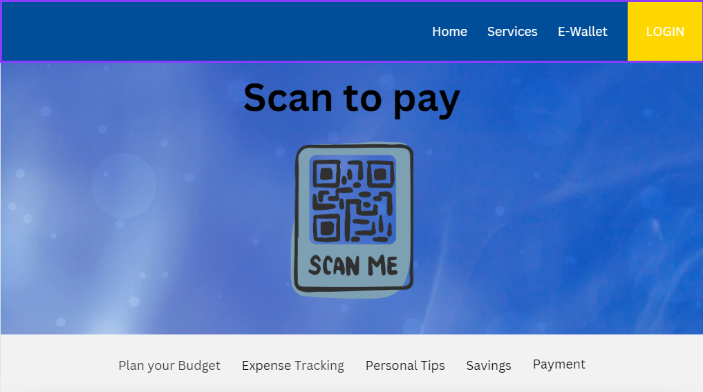
Payment page

Slide 17
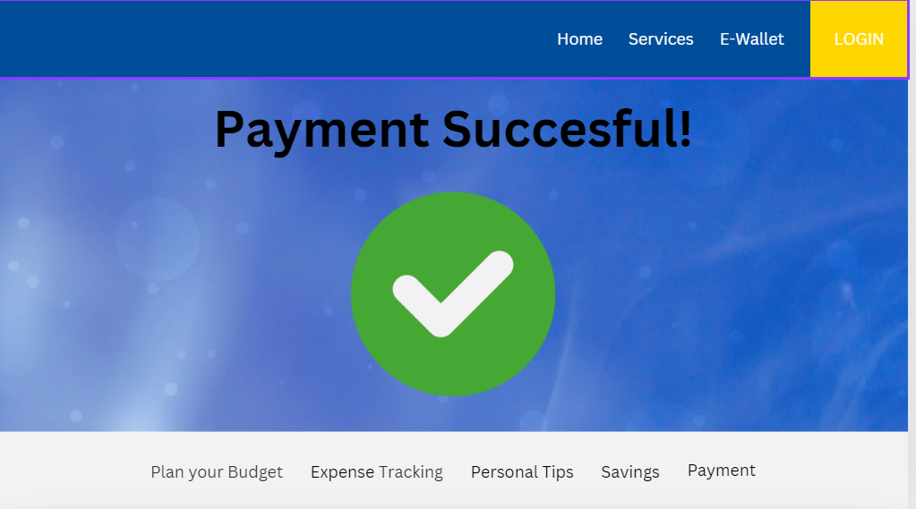
Payment Successful page

Slide 18
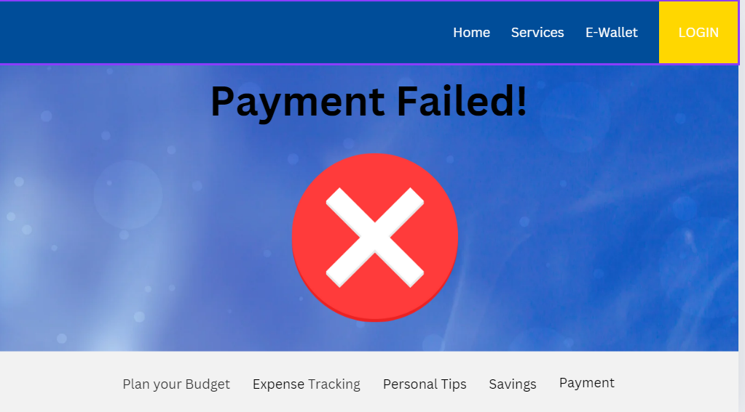
Payment Failed page

Slide 19
Canva link
https://www.canva.com/design/DAGG9qTS5AY/SY8W6wHnGgQUKSOausk-eg/edit?utm_content=DAGG9qTS5AY&utm_campaign=designshare&utm_medium=link2&utm_source=sharebutton

Slide 20
Reference Sources
https://www.linkedin.com/pulse/unlocking-financial-independence-deep-dive-digital-wallets-aodrc/ (SLIDE 4)

